Slide 1
ANALYSIS ON ETF
TEAM MEMBERS :
DEEP BORKAR FIRAS OBEID PARTH PATEL DHIVYA RAO

Slide 2
INTRODUCTION TO ETF
An Exchange-Traded Fund (ETF) is a security that tracks an index or basket of securities and is traded on an exchange.
ETFs are traded just like stocks, experiencing price fluctuations throughout the day.

Slide 3
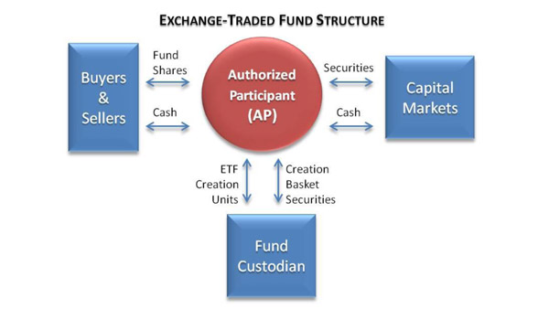

Slide 4
ADVANTAGES OF ETF
Low Expense Ratio Based on reports by Morgan Stanley Smith Barney ETF have an average expense ratio of 0.55 while mutual funds have about 1.34%
Tax Advantages ETF are more Tax beneficial than Mutual funds
Diversification Provides diversification of a mutual fund plus the flexibility of a stock
Transparency Holdings updated end of each day
Flexibility Prices are reported every 15 seconds

Slide 5
SELECTED ETF
AIRR: FIRST TRUST RBA AMERICAN INDUSTRIAL RENAISSANCE ETF
ISHARE S&P ASIA ETF
QQQ INVESCO
ROBO GLOBAL ROBOTICS AND AUTOMATION INDEX ETF
VANGUARD INFORMATION TECHNOLOGY ETF (VGT)

Slide 6
ROBO GLOBAL ROBOTICS AND AUTOMATION INDEX ETF
FUND DESCRIPTION
Major Investments - Robotics And Automation Companies
Index Followed - ROBO Global
Inception Date - 10/21/2013
Expense Ratio - 0.95%
Average Daily Share Volume - 193,955
Average Daily Collection - $7.77 Million.

Slide 7
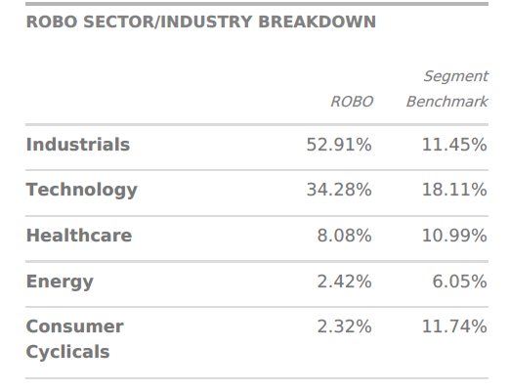
ASSET ALLOCATION
Net Assets Worth $1,499,578,289.40
Outstanding Shares Of 36,200,000
Net Asset Value : $41.42

Slide 8
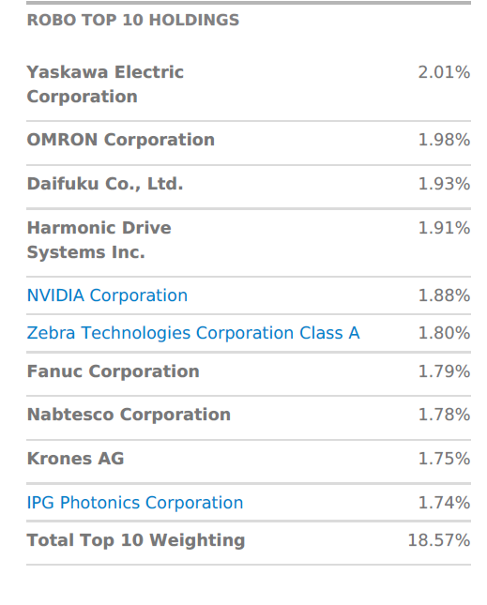

Slide 9
RISK LEVEL OF FUND
Beta – 1.05
Beta vs S&P is 0.84
Beta vs AWCI is 1.31
Standard deviation of 17.83%
Treynor Raio – 0.74%
Nasdaq Risk Assessment tool – 102

Slide 10
QQQ INVESCO
FUND DESCRIPTION
Major Investments - Large Companies in Non Banking sector
Issuer of Fund – Invesco QQQ Trust
Index Followed - NASAQ 100 Index
Inception Date - 10 th March 1999
Expense Ratio - 0.20%
Average Daily Share Volume - 28,885,912 shares
Average Daily Collection - $5.18 Billion

Slide 11
ASSET ALLOCATION
Net Assets Worth $74,002,284,009
Outstanding Shares Of 399.05M
Net Asset Value : $190.45

Slide 12
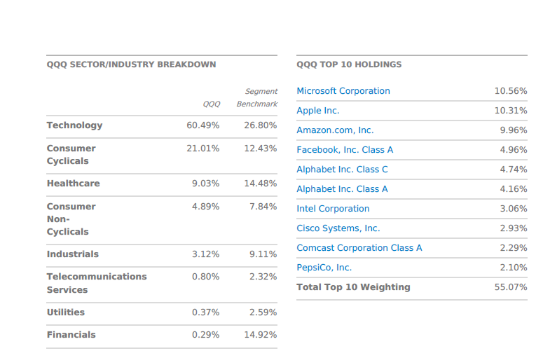

Slide 13
RISK LEVEL OF FUND
Beta – 1.29
Standard deviation of 27.95 %
Sharpe Ratio - 0.19%
Treynor Ratio – 10.76
Nasdaq Risk Assessment tool – 101
Not FDIC Insured and Not Bank Guaranteed

Slide 14
AIRR: FIRST TRUST RBA AMERICAN INDUSTRIAL RENAISSANCE ETF
FUND DESCRIPTION
Major Investments - Industrial and Commercial banking Sector
Issuer of Fund – First Trust
Index Followed - Richard Bernstein Advisors American Industrial Renaissance Index
Inception Date - 03/10/14
Expense Ratio - 0.95%
Average Daily Share Volume - 23,565
Average Daily Collection - $594.14K.

Slide 15
ASSET ALLOCATION
Net Assets Worth $79,762,067
Outstanding Shares Of 3,100,002
Net Asset Value : $25.73

Slide 16
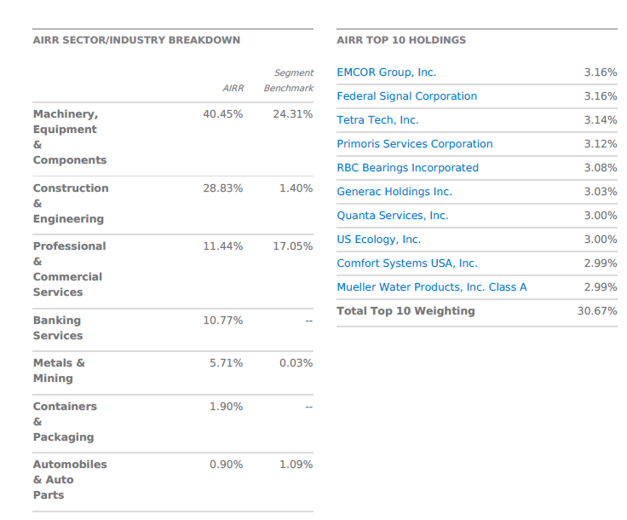

Slide 17
RISK LEVEL OF FUND
Beta – 1.26
Standard deviation of 19.62 %
Sharpe Ratio - 0.6 %
Treynor Ratio – 8.35%
Nasdaq Risk Assessment tool – 96
Not FDIC Insured and Not Bank Guaranteed

Slide 18
ISHARE S&P ASIA ETF
FUND DESCRIPTION
Major Investments - Large Companies in Asia
Issuer of Fund – BlackRock Trust
Index Followed - S&P Asia 50 Index
Inception Date - 11/13/07
Expense Ratio - 0.50%
Average Daily Share Volume - 48,554 shares
Average Daily Collection - $2.99M

Slide 19
ASSET ALLOCATION
Net Assets Worth 1.09B
Outstanding Shares Of 604,700,000
Net Asset Value $62.70

Slide 20
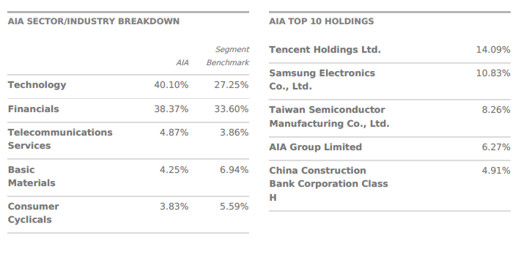

Slide 21
RISK LEVEL OF FUND
Beta – 1.09
Standard deviation of 13.7 %
Sharpe Ratio - 0.95 %
Treynor Ratio – 11.91%
Nasdaq Risk Assessment tool – 74
Not FDIC Insured and Not Bank Guaranteed

Slide 22
VANGUARD INFORMATION TECHNOLOGY ETF (VGT)
FUND DESCRIPTION
Major Investments – Information Technology Companies
Issuer of Fund – Vanguard
Index Followed - MSCI US Investable Market Information Technology
25/50 Index
Inception Date - 01/26/04
Expense Ratio – 0.10%
Average Daily Share Volume - 556,092 shares
Average Daily Collection - $111.89M

Slide 23
ASSET ALLOCATION
Net Assets Worth 21.57B
Outstanding Shares Of 759,206,416
Net Asset Value $212.95

Slide 24
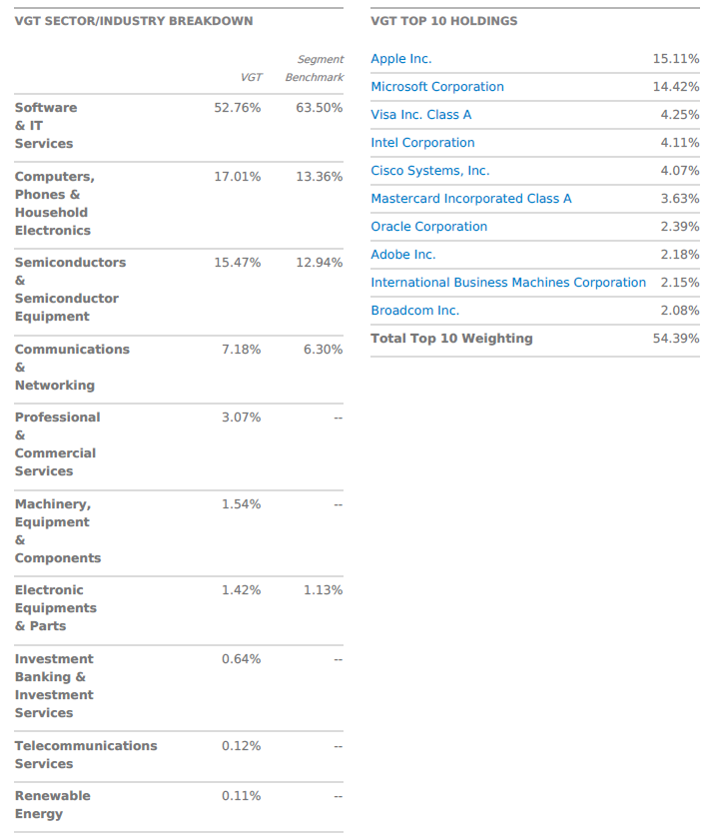

Slide 25
RISK LEVEL OF FUND
Beta – 0.97
Standard deviation of 15.97%
Sharpe Ratio - 1.21 %
Treynor Ratio – 20.33%
Nasdaq Risk Assessment tool – 104
Not FDIC Insured and Not Bank Guaranteed

Slide 26
Cross – Sectional and Time-Series data

Slide 27

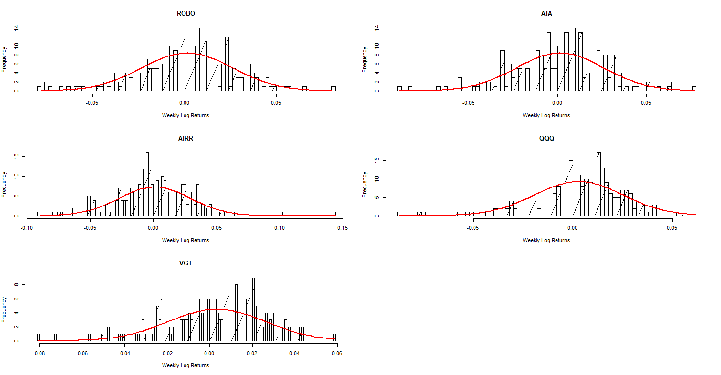

Slide 28
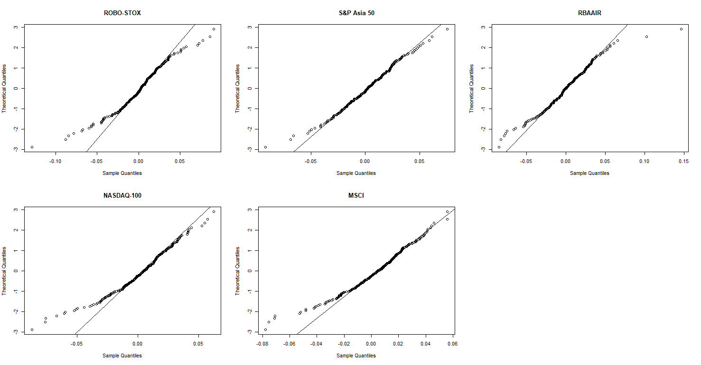

Slide 29
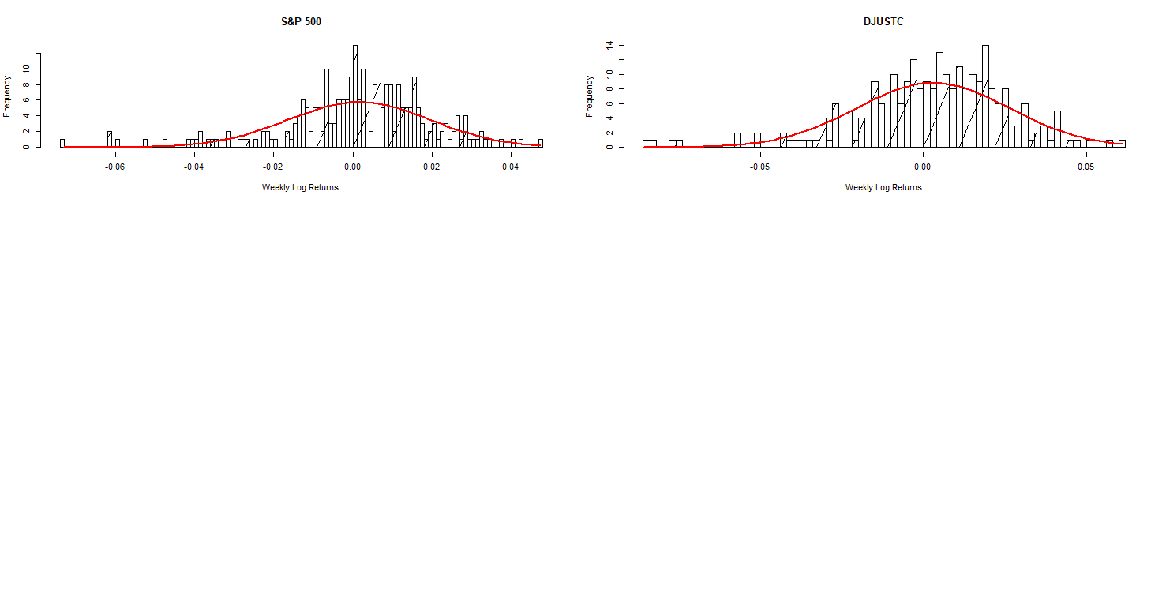

Slide 30
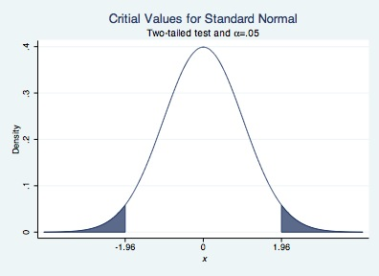
Two-Tailed Hypothesis Testing of the Mean with Known Variance
alpha = 5%
z_{α∕2} is the 100(1 − α∕2) percentile of the standard normal distribution
Z-Value
ROBO 0.04696660
AIA -0.20353814
AIRR 0.06266554
QQQ 0.04734285
VGT 0.25610871
-1.959964 | 1.959964

Slide 31
Type II Error in Two-Tailed Test of Population Mean with Known Variance
Annual Means Boundaries | Lower Rejection Bounds | Upper Rejection Bound | Hypothetical Mean Of Funds
ROBO-STOX | 0.04546045 | 0.09386222 | 0.06966134
S&P Asia 50 | 0.07129223 | 0.11170971 | 0.09150097
RBAAIR | 0.01751380 | 0.06755129 | 0.04253255
NASDAQ-100 | 0.13303137 | 0.17272018 | 0.15287578
MSCI | 0.13585511 | 0.17445808 | 0.15515660
We compute the lower and upper bounds of sample means for which the null hypothesis (μ = Index mean) would not be rejected.

Slide 32
Type-II Error Probability of Each ETF
 | Lower Tail P1 | Lower Tail P2 | P(Type II error)
ROBO-STOX | ROBO | 1.076256e-02 | 0.9475215 | 0.9367590
S&P Asia 50 | AIA | 3.112785e-01 | 0.9996956 | 0.6884171
RBAAIR |AIRR | 7.935870e-03 | 0.9342325 | 0.9262966
NASDAQ-100 | QQQ | 1.068570e-02 | 0.9472301 | 0.9365444
MSCI | VGT | 7.039105e-05 | 0.5450394 | 0.5449690

Slide 33
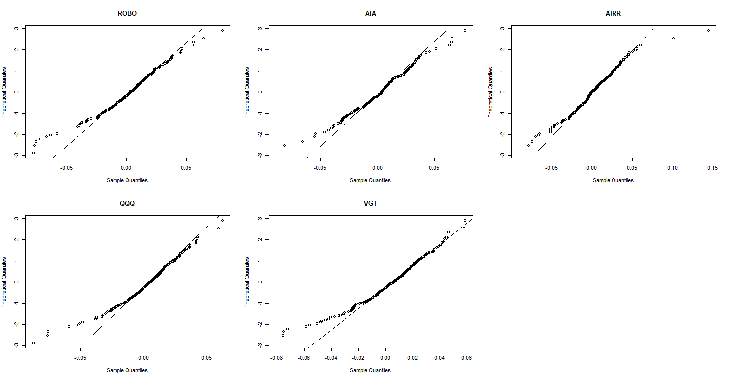
Shapiro Test of Normality

Slide 34
Tracking Error

Slide 35
Tracking Difference
Tracking Difference – It is the difference between the performance of the ETF fund and the performance of the index it tracks
Tracks Discrepancy with the Index the fund tracks

Slide 36
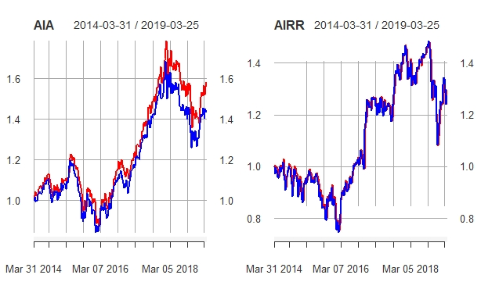

Slide 37
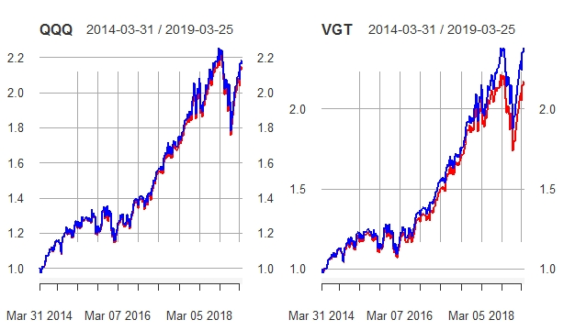

Slide 38
Tracking Error
Volatility of the difference between the performance of the ETF and its Index
It is a measure variability
Calculated as follows:
Tracking Error = Standard Deviation of (P - B)
P - ETF Return
B – Benchmark Index Return
Interpretation

Slide 39
Tracking Error for Our Data
ETF | Tracking Index | Tracking Error (Weekly)
ROBO | ROBO – STOX GLOBAL | 0.094%
AIA | S&P Asia 50 Index | 0.22%
AIRR | RBA-AIRR Index | 0.25%
QQQ | Nasdaq 100 Index | 0.017%
VGT | MSCI World IT Index | 0.019%
Several Factors Affect the Tracking Error
Expense Ratio
Degree of Index Replication
Securities Lending

Slide 40
Expense Ratio
ETF | Tracking Index | Tracking Error (Weekly) | Expense Ratio
ROBO | ROBO – STOX GLOBAL | 0.094% | 0.95%
AIA | S&P Asia 50 Index | 0.22% | 0.50%
AIRR | RBA-AIRR Index | 0.25% | 0.70%
QQQ | Nasdaq 100 Index | 0.017% | 0.20%
VGT | MSCI World IT Index | 0.019% | 0.10%

Slide 41
Index Replication
TE = 0.25%
TE = 0.094%

Slide 42
Index Replication
TE = 0.017%
TE = 0.019%

Slide 43
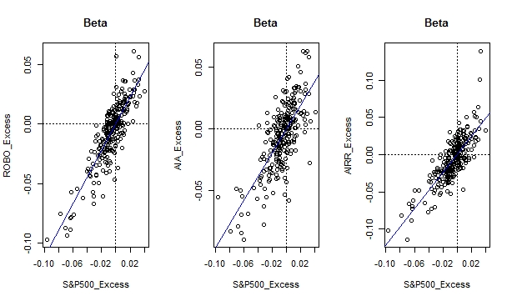
Factor Model to Estimate Alpha & Beta
1.124
0.958
1.214

Slide 44
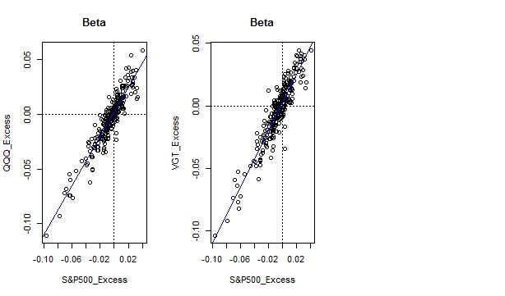
1.122
1.127

Slide 45
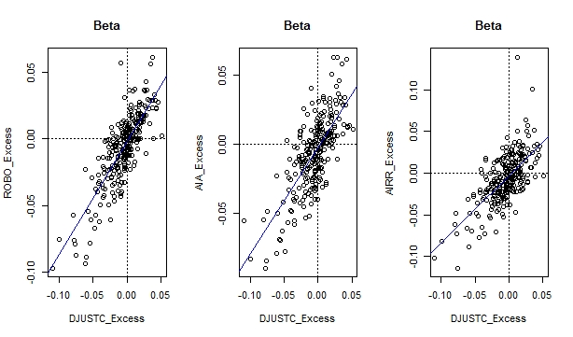
0.853
0.769
0.806

Slide 46
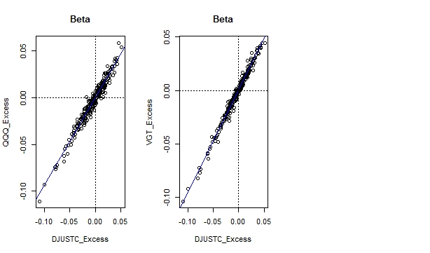
0.941
0.967

Slide 47
Alpha
 | S & P 500 Index | Dow Jones Tech Index
ROBO | 0.0005516971 | -0.0021752784
AIA | -0.0003896660 | -0.0025158935
AIRR | 0.0005943913 | -0.0028824008
QQQ | 0.0021228079 | -0.0001824235
VGT | 0.0024804471 | 0.0002652822
Alpha indicates how well you performed than the market.

Slide 48
ANOVA
Analysis of variance (ANOVA)
is a collection of variation statistical models
It is a statistical methods that separate data variance into different components for a test
associated estimation procedures used to analyze the differences among group means
developed by Ronald Fisher
Variance is decided into components attributable to different sources of variation.
Useful for more than two variables in a data
More conservative
Resulting in fewer type 1 error
Wide range of practical uses
If no true variance exists between the groups, the ANOVA's F-ratio should equal close to 1.

Slide 49
Background and Terminology
Generates an random null hypothesis from our futures value and compares with an alternative hypothesis
One of exploratory data analysis method(Operating function on individual features to indicate the variance of each individual features
Comparing mean squares along with F-test
F = explained variance/ unexplained variance
= Between group variability/ within group variability
In short, ANOVA is a statistical tool used in several ways to develop and confirm an explanation for the observed data.

Slide 50
Types of ANOVA
ANCOVA
One –way ANOVA
Two –way ANOVA
MANOVA
Explained variation ANOVA
Repeated measure ANOVA
Molecular variance ANOVA

Slide 51
Key Differences Between T-test and ANOVA
Residual = Actual R - Predicted R
R2 = Explained variable / Total variable
The T-test is used to compare the means of two populations. In contrast,
F-test is used to compare two population variances.
A hypothesis test that is used to compare the means of two populations is called t-test. A statistical technique that is used to compare the means of more than two populations is known as Analysis of Variance or ANOVA.

Slide 52
Covariance and Correlation
A measure of "linear dependence/joint variability” between the two random variables.
a greater values of a one variable correlate positively with a greater values of another variable.
AIRR has a higher covariance (0.0008086) amongst other ETFs,

Slide 53
Covariance with S&P 500 and Dow
QQQ, VGT and AIRR are the ETFs which positively and highly corresponds with S&P 500 in our portfolio following behind ROBO and AIA.
Moreover, a covariance with DJUSTC also depict a similar relation as with S&P 500 where VGT is on a top.

Slide 54
Correlation with S&P 500 and Dow
Correlation gives a better idea comparatively to a covariance.
Where, if we look into number very closely then we find that ROBO has good correlation of 0.8396 with S&P 500 even though its covariance is still less.
With increase of correlation risk will also be rise, as AIA is a least correlated with indices S&P 500 and DJUSTC, when an index perform worst it will have less effect on AIA then VGT and QQQ because VGT is highest related to DJUSTC and QQQ performs better with S&P 500.

Slide 55
Correlation with themselves
As every ETFs best correlate with themselves by having 1.0 correlation constant.
VGT and QQQ both has second highest correlation between each other as they both are very close to follow indices.
AIRR and AIA shows close relationship whereas ROBO has a higher correlation ship with VGT.
Here, we can imply that correlation of one with another doesn’t mean that other ETF has also a same relationship, it might be different.

Slide 56
Results of Covariance
ROBO AIA AIRR QQQ VGT
ROBO 0.0006127615 0.0004773045 0.0005385150 0.0004425401 0.0004662830
AIA 0.0004773045 0.0006137497 0.0003588005 0.0003855250 0.0004060874
AIRR 0.0005385150 0.0003588005 0.0008086392 0.0004108983 0.0004401474
QQQ 0.0004425401 0.0003855250 0.0004108983 0.0005056046 0.0005035876
VGT 0.0004662830 0.0004060874 0.0004401474 0.0005035876 0.0005301486

Slide 57
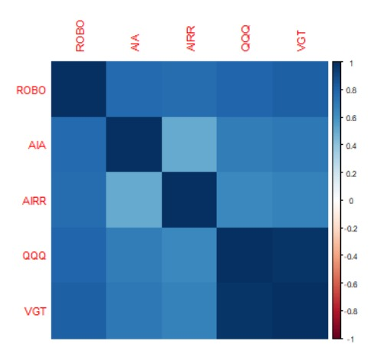
Covariance

Slide 58
Results of Correlation
ROBO AIA AIRR QQQ VGT
ROBO 1.0000000 0.7783128 0.7650233 0.7950626 0.8180975
AIA 0.7783128 1.0000000 0.5093074 0.6920721 0.7119099
AIRR 0.7650233 0.5093074 1.0000000 0.6426158 0.6722363
QQQ 0.7950626 0.6920721 0.6426158 1.0000000 0.9726816
VGT 0.8180975 0.7119099 0.6722363 0.9726816 1.0000000

